Slide 1
Microservice Architecture
Virendra Singh

Slide 2
Agenda
Introduction of software architectures : Monolithic and Microservice
Pros and cons of both the architectures
Issues to address while implementing Microservice Architectures and their possible solutions

Slide 3
Successful software development
Architecture
Process
Organization
Agile
Continuous delivery
Small
Autonomous teams

Slide 4
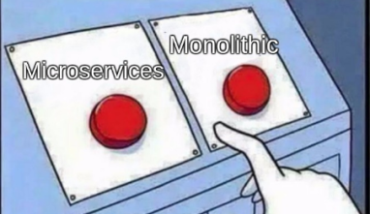
Architecture ?

Slide 5
Fictitious e-commerce application
“that takes orders from customers, verifies inventory and available credit, and ships them. The application consists of several components including the StoreFrontUI, which implements the user interface, along with some backend services for checking credit, maintaining inventory and shipping orders.”

Slide 6
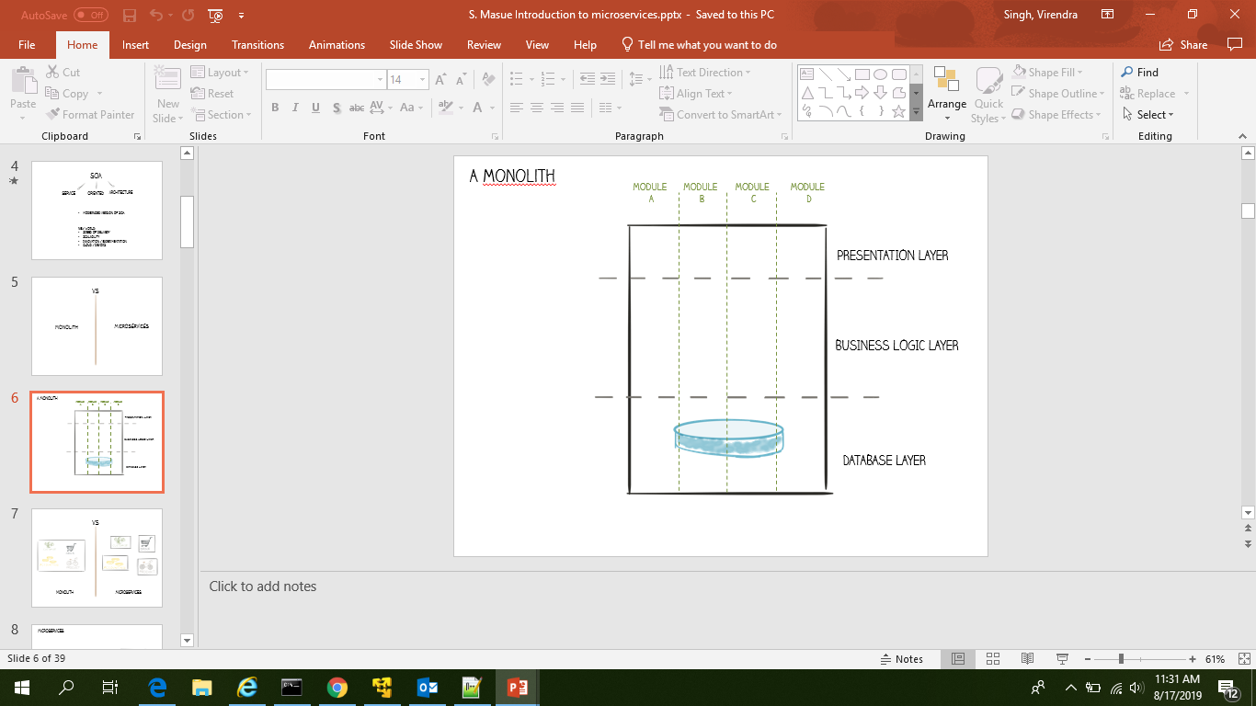
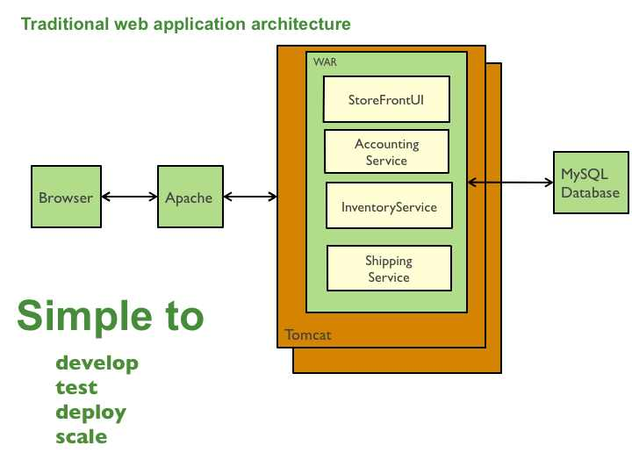
Monolithic Architecture
But… successful applications have a problem “keeps growing”
Notes:
Simple to develop: Monolithic applications are very simple to develop because current development tools and IDEs support the development of monolithic applications
Simple to test: As we have already discussed, monolithic applications have all of their modules in a single artifact, so you can easily carry out end-to-end testing by simply running the application either manually or with Selenium
Simple to deploy: A monolithic application is a single artifact, so you can easily deploy it to the server as a WAR file
Simple to scale: You can easily achieve scaling by copying the single artifact of the application to multiple running machines and setting up a load balancer behind the monolithic application

Slide 7
Monolithic Architecture
Drawbacks of Monolithic Architecture in context of..
Development
Testing
Deployments
Scalability
Introduction of new technology
Notes:
Development.. No clarity on responsibility ; shared model classes ; one service memory leakage can cause whole system down
Test : everything every time
Deployment : deployment everything every time even for minor change in particular area, deployment time keep on increasing
Scalability: costly affair
Introduction to new technology --- really difficult

Slide 8
Monolithic Architecture
Drawbacks of Monolithic Architecture Development
This simple approach has a limitation in size and complexity.
Application is too large and complex to fully understand and made changes fast and correctly.
The size of the application can slow down the start-up time.
You must redeploy the entire application on each update.
Impact of a change is usually not very well understood which leads to do extensive manual testing.
Continuous deployment is difficult.
Monolithic applications can also be difficult to scale when different modules have conflicting resource requirements.
Another problem with monolithic applications is reliability. Bug in any module (e.g. memory leak) can potentially bring down the entire process. Moreover, since all instances of the application are identical, that bug will impact the availability of the entire application.
Monolithic applications has a barrier to adopting new technologies. Since changes in frameworks or languages will affect an entire application it is extremely expensive in both time and cost.

Slide 9
Successful Software Development
Monolithic Architecture
Process
Organization
Agile
Continuous delivery
Small
Autonomous teams
So what is the solution? Yes it is “Microservice Architecture”

Slide 10
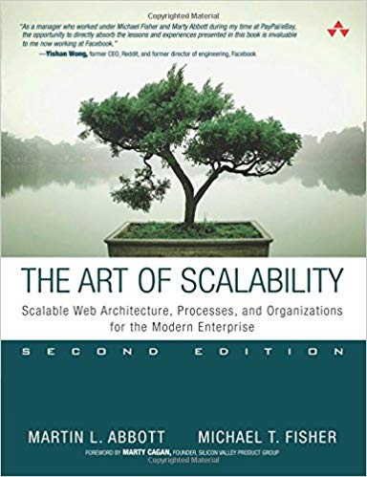
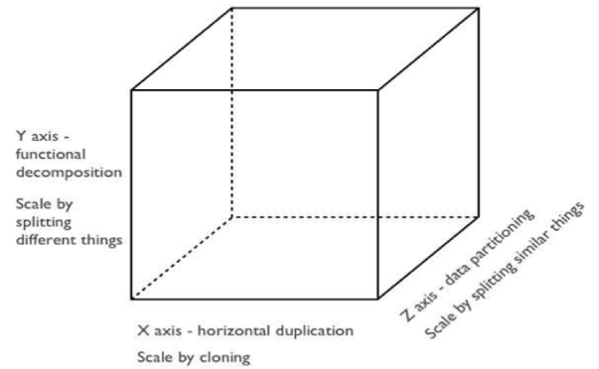
Scaling strategies
Scale cube

Slide 12
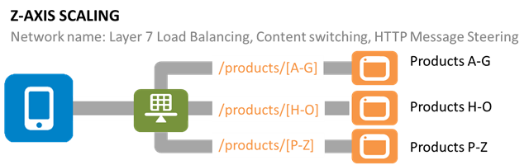

Slide 13
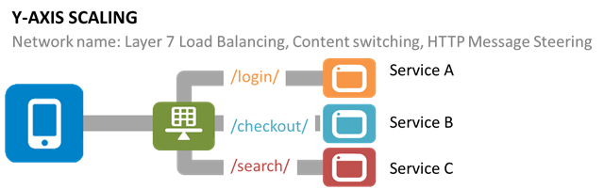

“Microservice architecture is basically applying functional decomposition“

Slide 14


Microservice Architecture
Accounting Service
Accounting
Database
Rest
Inventory Service
Inventory
Database
Inventory Service
http
API
Gateway
ShopFront UI
Rest
Shipping Service
Shipping
Database
Rest
….
Services
…
Database

Slide 15
Advantages of Microservice Architecture
microservice architecture gives a team the freedom to independently develop, test and deploy services.
Easy to understand since each microservice represents a small piece of functionality, and easy to modify for developers, thus they can help a new team member become productive quickly.
Better fault isolation; if one microservice fails, the others will continue to work.
Code for different services can be written in different technology ( framework , language etc.)
The microservice architecture enables continuous delivery.
Scalability and reusability, as well as efficiency. Easy to scale and integrate with third-party services.
Microservices simplify security monitoring because the various parts of an app are isolated. A security problem could happen in one section without affecting other areas of the project.

Slide 16

Successful Software Development
Microservice Architecture
Process
Organization
Agile
Continuous delivery
Small
Autonomous teams

Slide 17
Drawbacks of Microservice Architecture
Complexity of developing a distributed system
Implementing interservice communication
Handling partial failures / slow service response
Complexity of implementing business transaction that span multiple database.
Complexity of testing a distributed system
Complexity of deploying and operating a distributed system
Managing the development and deployment of features that span multiple services
“Fortunately solutions exists”
“the benefits typically outweigh the drawbacks for large, complex application”

Slide 18
Issues to address
How to partition the system into services?
How do client of the application communicate with the services?
How do the services communicate to each other?
How to deploy the services?
How to deal with distributed data management problems?
Distributed Logging Architecture and Request Tracing for Microservices.

Slide 19
How to decompose the application into services?
This is very much an art, but there are a number of strategies that can help:
Decompose by business capability and define services corresponding to business capabilities
Decompose by verb or use case and define services that are responsible for particular actions.
A Shipping service that’s responsible for shipping complete orders.
Decompose by nouns or resources by defining a service that is responsible for all operations on entities/resources of a given type.
E.g. an Account Service that is responsible for managing user accounts.
Ideally, each service should have only a small set of responsibilities. (Uncle) Bob Martin talks about designing classes using the Single Responsibility Principle (SRP). The SRP defines a responsibility of a class as a reason to change, and states that a class should only have one reason to change. It make sense to apply the SRP to service design as well.

Slide 20
Issues to address
How to partition the system into services?
How do client of the application communicate with the services?
How do the services communicate to each other?
How to deploy the services?
How to deal with distributed data management problems?
Distributed Logging Architecture
Request Tracing for Microservices.

Slide 21
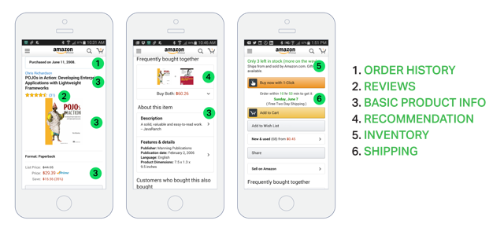
How do client of the application communicate with the services?
When using a monolithic application architecture,
(GET api.company.com/productdetails/productId)

Slide 22
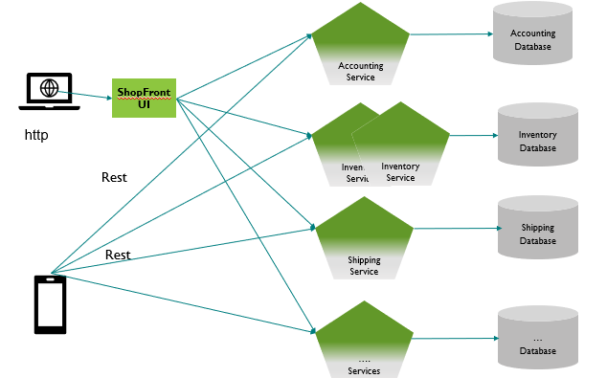
How do client of the application communicate with the services?
Direct client-to-microservice communication
Drawbacks:
Client tightly coupled with each microservice
Intelligent client is required (variety of protocols)
Too many round trips:
Security issues

Slide 23
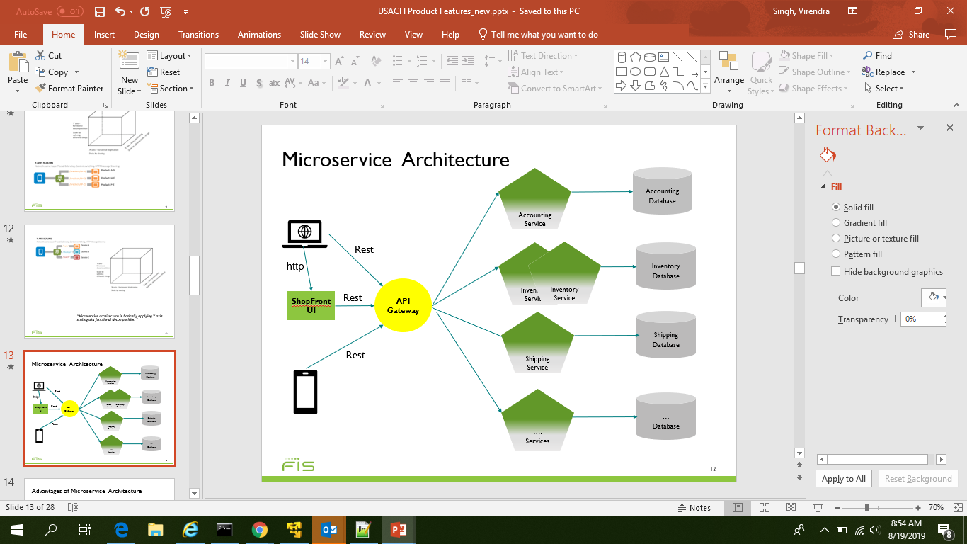
How do client of the application communicate with the services?
Using an API Gateway
Insulates the clients from how the application is partitioned into microservices
Insulates the clients from the problem of determining the locations of service instances
Reduces the number of requests/roundtrips.
Translates from a “standard” public web-friendly API protocol to whatever protocols are used internally

Slide 24
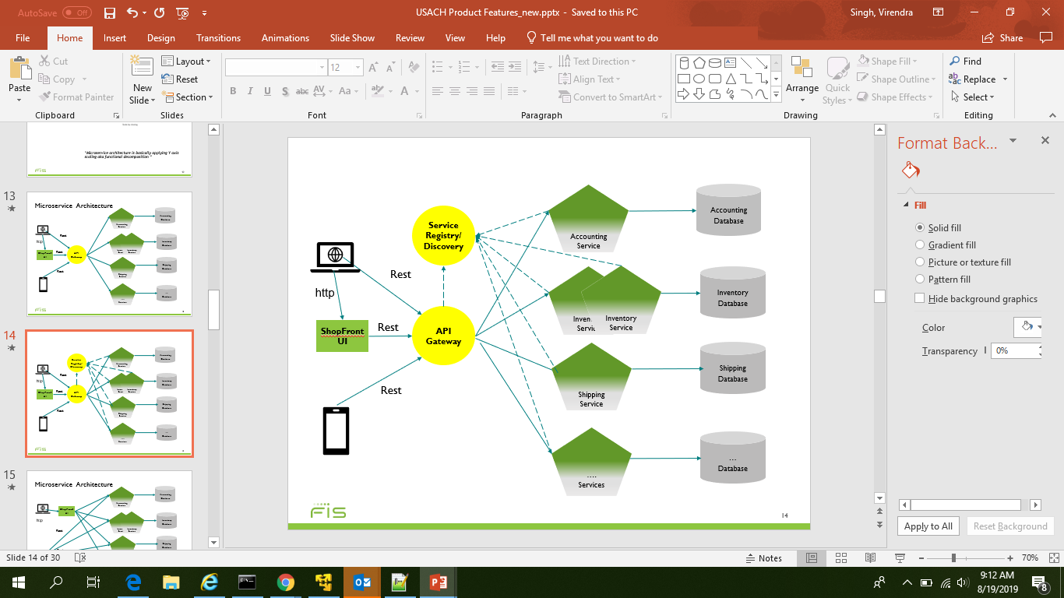
How do client of the application communicate with the services?
Using an API Gateway with Service Registry

Slide 25
Issues to address
How to partition the system into services?
How do client of the application communicate with the services?
How do the services communicate to each other?
How to deploy the services?
How to deal with distributed data management problems?
Distributed Logging Architecture
Request Tracing for Microservices.

Slide 26
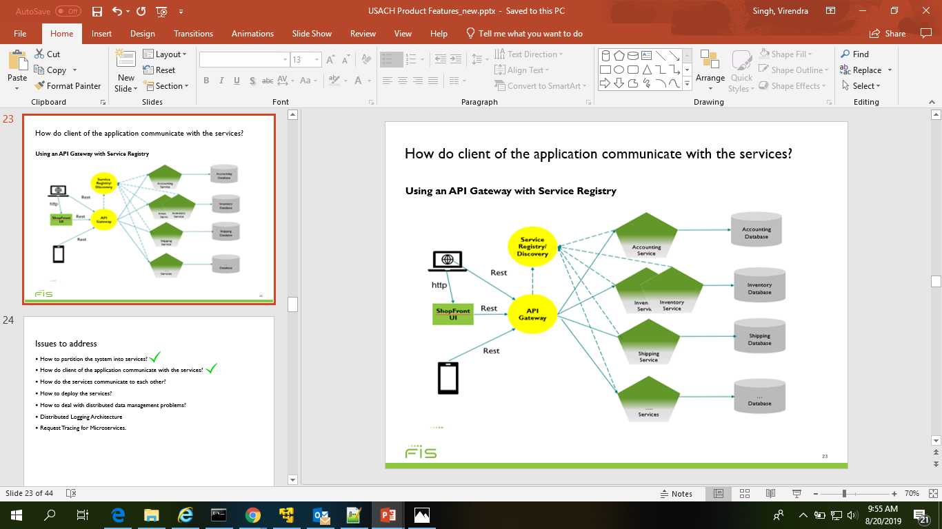
How do the services communicate to each other?
Communication types:
The first dimension is whether the interaction is one‑to‑one or one‑to‑many:
One‑to‑one – Each client request is processed by exactly one service instance.
One‑to‑many – Each request is processed by multiple service instances.
The second dimension is whether the interaction is synchronous or asynchronous:
Synchronous – The client expects a timely response from the service and might even block while it waits.
Asynchronous – The client doesn’t block while waiting for a response, and the response, if any, isn’t necessarily sent immediately

Slide 27
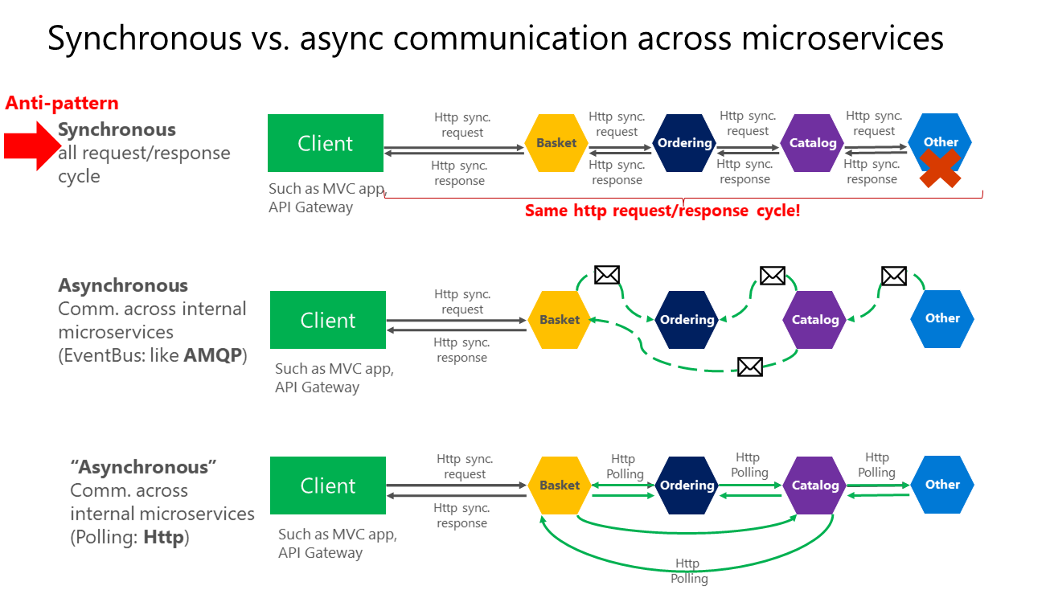
How do the services communicate to each other?
Synchronous Communication: http protocol is used to communication.

Slide 28
How do the services communicate to each other?
Synchronous Communication: http protocol is used to communication.
In case of partial failure
Network timeouts
Limiting the number of outstanding requests
Circuit breaker pattern
Provide fallbacks
Notes:
Network timeouts – Never block indefinitely and always use timeouts when waiting for a response. Using timeouts ensures that resources are never tied up indefinitely.
Limiting the number of outstanding requests – Impose an upper bound on the number of outstanding requests that a client can have with a particular service. If the limit has been reached, it is probably pointless to make additional requests, and those attempts need to fail immediately.
Circuit breaker pattern – Track the number of successful and failed requests. If the error rate exceeds a configured threshold, trip the circuit breaker so that further attempts fail immediately. If a large number of requests are failing, that suggests the service is unavailable and that sending requests is pointless. After a timeout period, the client should try again and, if successful, close the circuit breaker.
Provide fallbacks – Perform fallback logic when a request fails. For example, return cached data or a default value such as an empty set of recommendations.

Slide 29
How do the services communicate to each other?
Asynchronous Communication: high throughput messaging system like (Apache Kafka) is used.

Slide 30
Issues to address
How to partition the system into services?
How do client of the application communicate with the services?
How do the services communicate to each other?
How to deploy the services?
How to deal with distributed data management problems?
Distributed Logging Architecture
Request Tracing for Microservices.

Slide 31
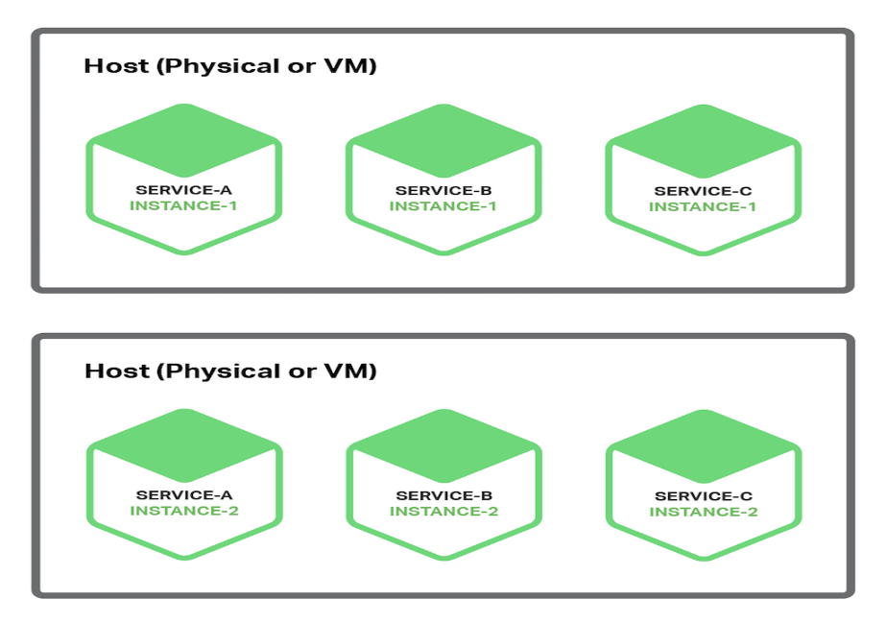
How to deploy the services?
Multiple Service Instances per Host Pattern
there is little or no isolation of the service instances
It’s possible for a misbehaving service instance to consume all of the memory or CPU of the host.
Services can be written in a variety of languages and frameworks, so there are lots of details that the development team must share with operations

Slide 32
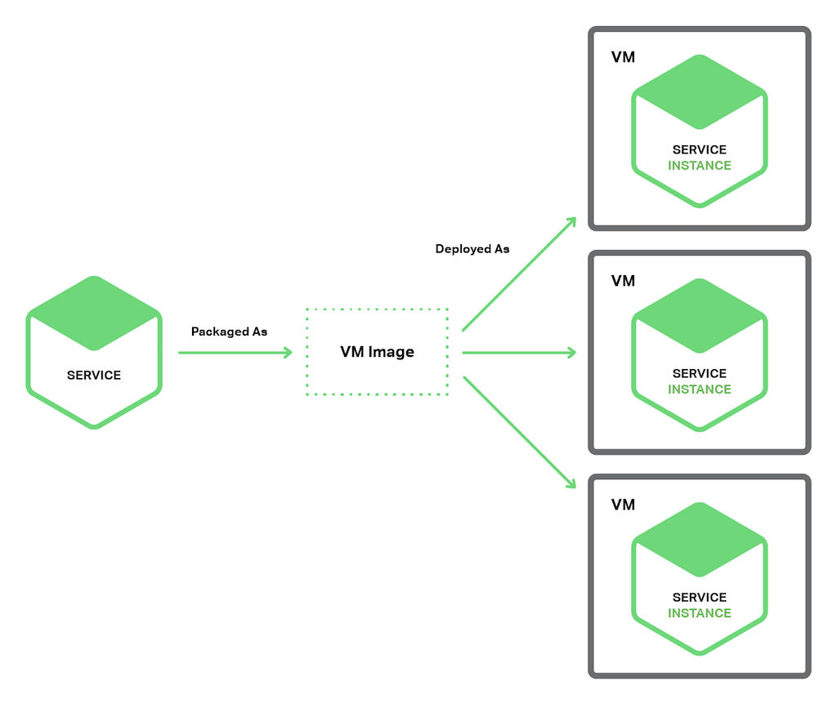
How to deploy the services?
Service Instance per Virtual Machine Pattern
Advantage :
service instance runs in complete isolation.
It has a fixed amount of CPU and memory and can’t steal resources from other services.
encapsulates your service’s implementation technology
Deployment becomes much simpler and more reliable.
Disadvantage:
less efficient resource utilization.
VM images are typically slow to build due to their size.
are typically slow to instantiate

Slide 33
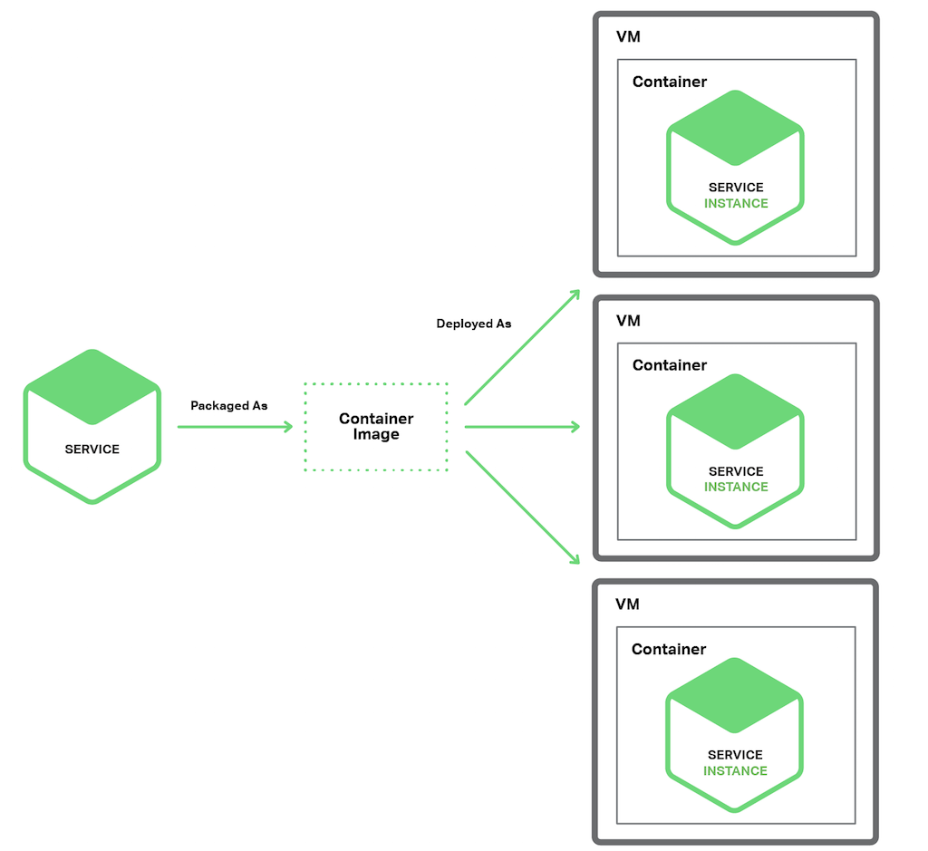
How to deploy the services?
Service Instance per Continer Pattern
Advantage :
similar to those of VMs.
unlike VMs, containers are a lightweight technology. Container images are typically very fast to build
Deployment becomes much simpler and more reliable.
When a container starts, what runs is the service.
Disadvantage:
While container infrastructure is rapidly maturing, it is not as mature as the infrastructure for VMs..
containers are not as secure as VMs since the containers share the kernel of the host OS with one another.

Slide 34
Issues to address
How to partition the system into services?
How do client of the application communicate with the services?
How do the services communicate to each other?
How to deploy the services?
How to deal with distributed data management problems?
Distributed Logging Architecture
Distributed Request Tracing for Microservices.

Slide 35
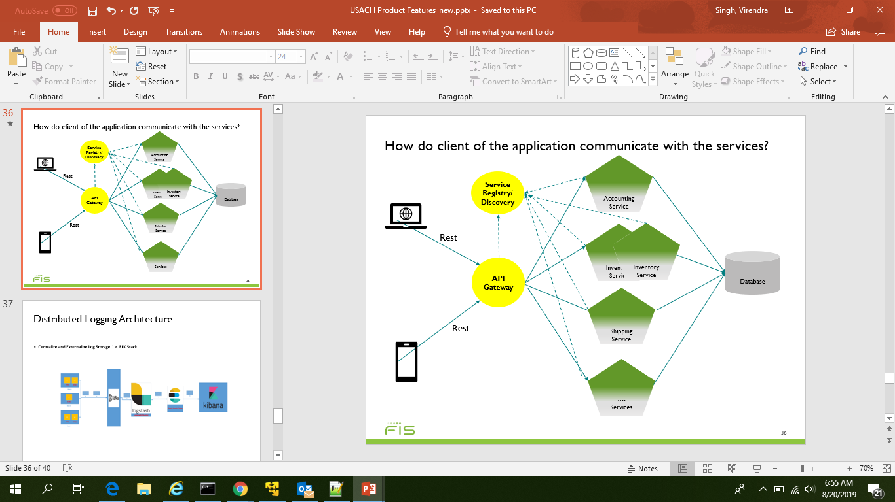
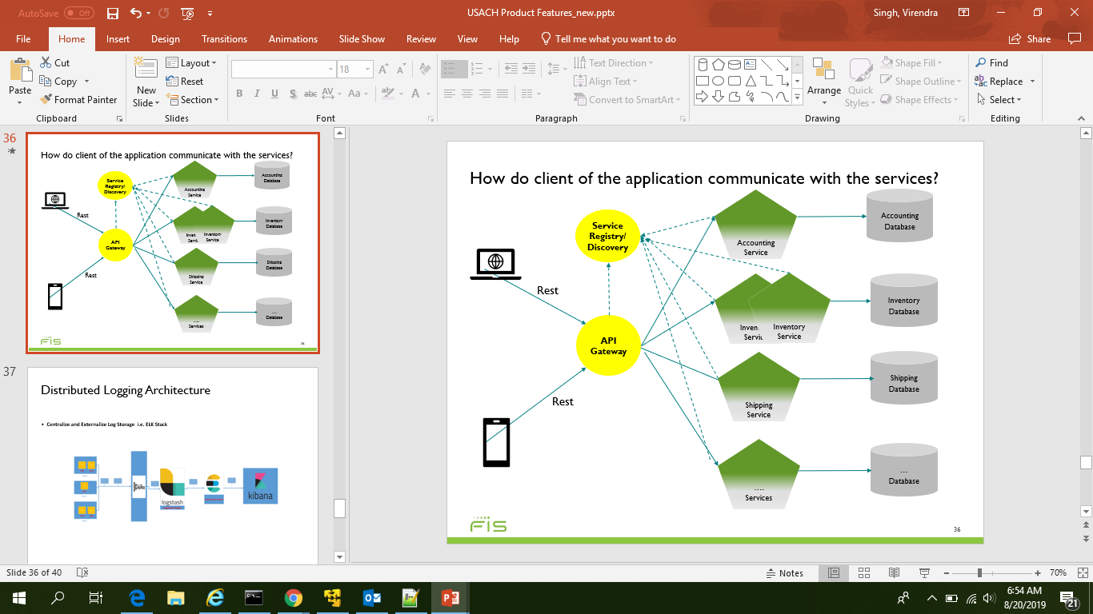
How to deal with distributed data management problems?
Data Management Patterns:
Shared Database
Database per service

Slide 36
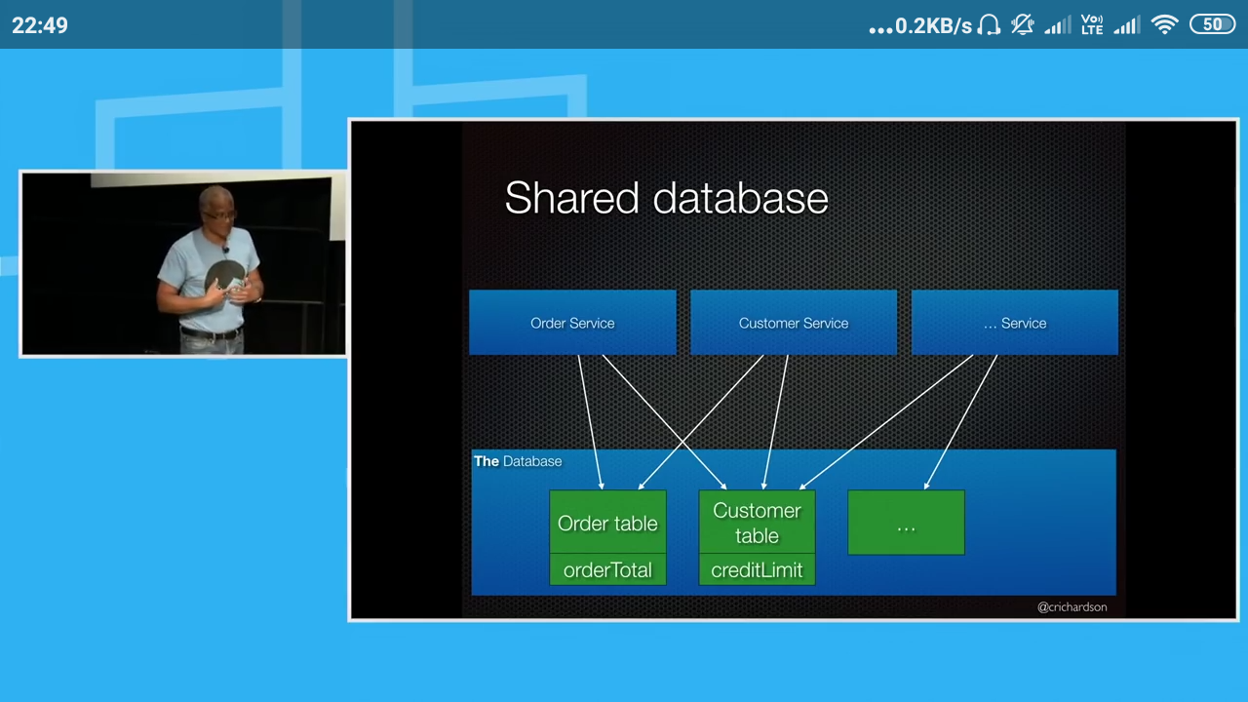

Slide 37
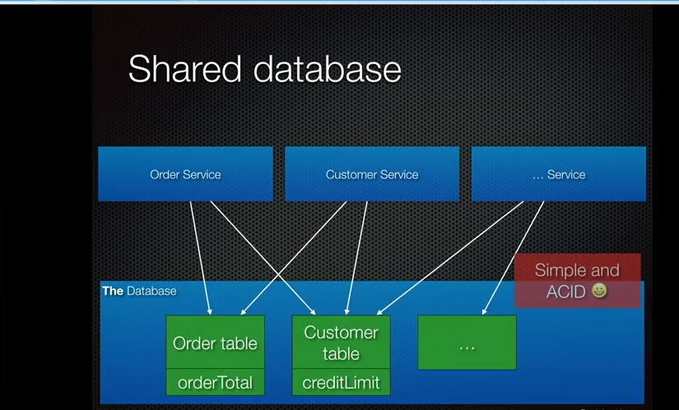

Slide 38
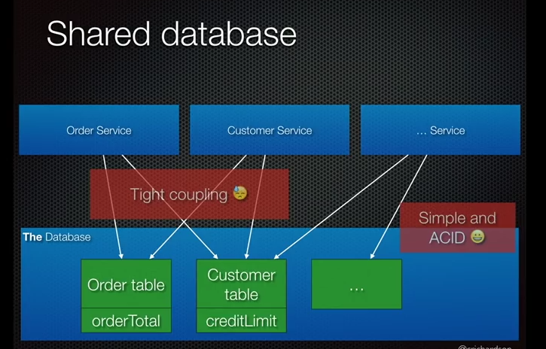

Slide 39
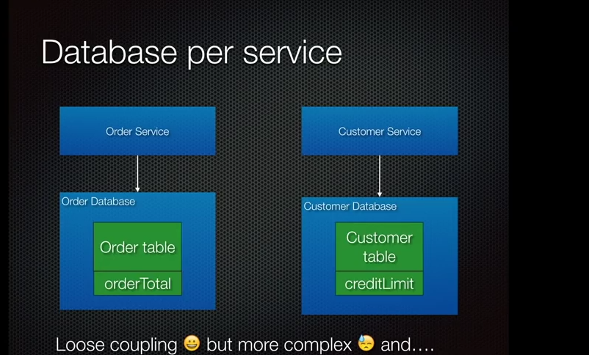

Slide 40
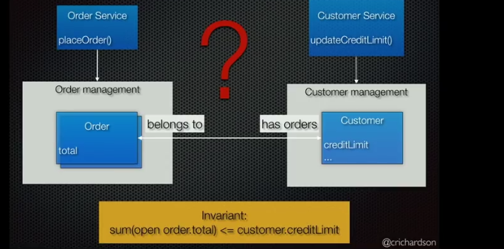

Slide 41
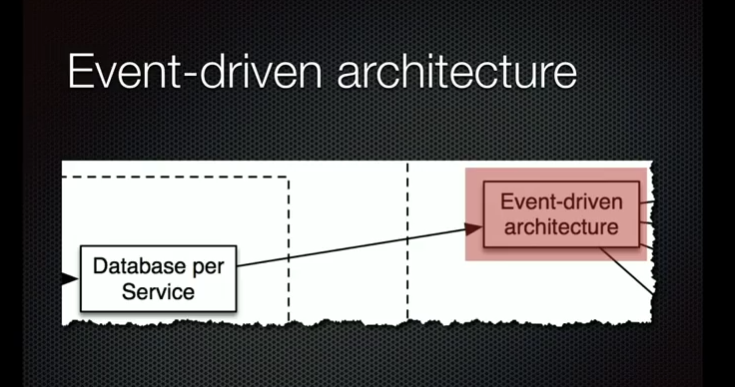

Slide 42
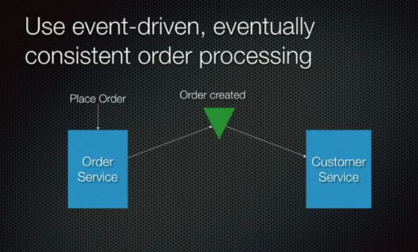

Slide 43
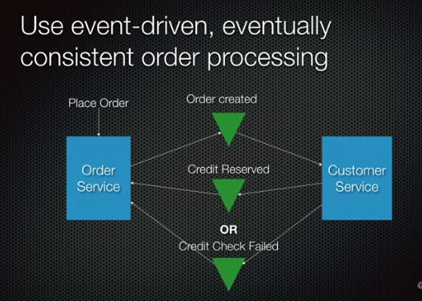

Slide 44
Issues to address
How to partition the system into services?
How do client of the application communicate with the services?
How do the services communicate to each other?
How to deploy the services?
How to deal with distributed data management problems?
Distributed Logging Architecture
Distributed Request Tracing for Microservices.

Slide 45
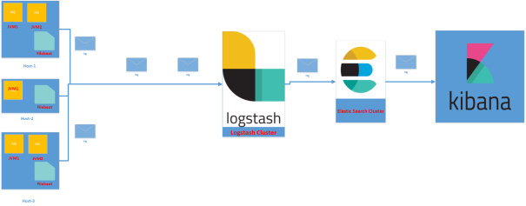
Distributed Logging Architecture
ELK Stack
E- Elasticsearch - Elasticsearch is a distributed, open source search and analytics engine for all types of data, including textual, numerical, geospatial, structured, and unstructured
L- Logstash - Logstash is an open source tool for collecting, parsing, and storing logs for futureuse
K- Kibana- Kibana is a web interface that can be used to search and view the logs that Logstash has indexed on elasticsearch.

Slide 46
Issues to address
How to partition the system into services?
How do client of the application communicate with the services?
How do the services communicate to each other?
How to deploy the services?
How to deal with distributed data management problems?
Distributed Logging Architecture
Distributed Request Tracing for Microservices.

Slide 47
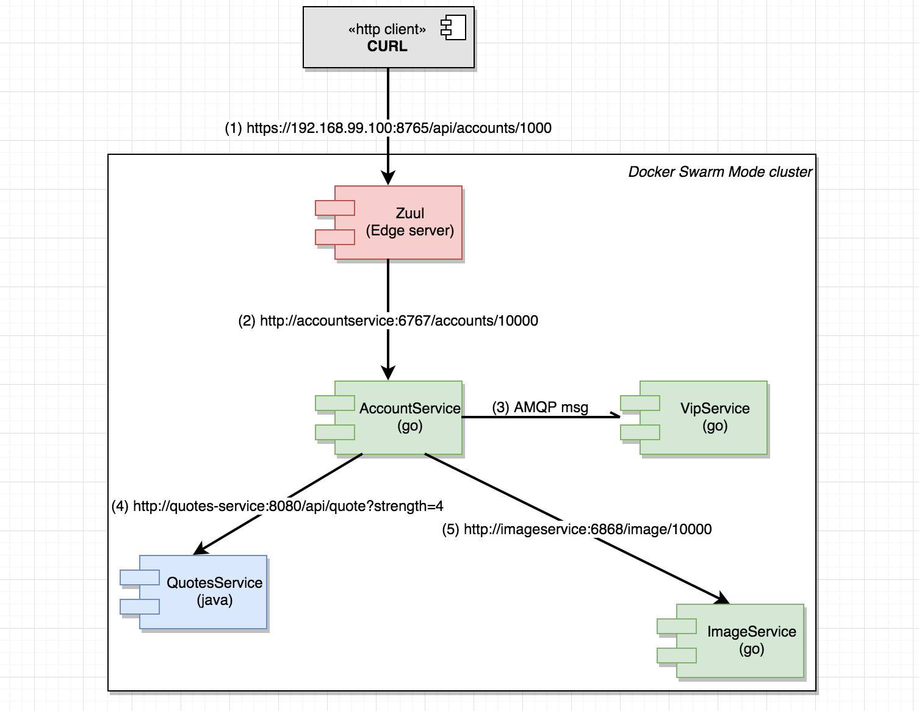
Distributed Tracing of request
Use Spring Cloud Zipkin and Spring Cloud Sleuth

Slide 48
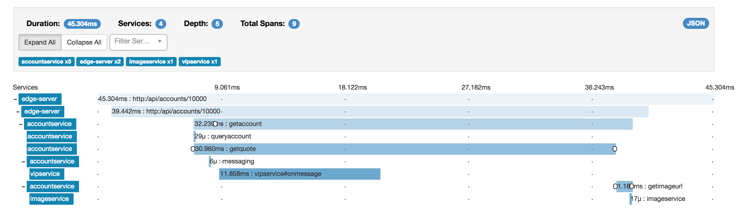
Distributed Tracing of request

Slide 49
Issues to address
How to partition the system into services?
How do client of the application communicate with the services?
How do the services communicate to each other?
How to deploy the services?
How to deal with distributed data management problems?
Distributed Logging Architecture
Distributed Request Tracing for Microservices.

Slide 50

References
https://dzone.com/microservices-news-tutorials-tools
https://www.nginx.com/blog/tag/microservices-architecture/
https://microservices.io/patterns/microservices.html
Youtube- Talks
https://www.udemy.com/course/evolution-of-microservices/
https://www.udemy.com/microservices-with-spring-boot-and-spring-cloud/
Book - Microservices: Flexible Software Architecture
https://github.com/singhvirendra18gmailcom/Microservice-Architecture

